Slide 1
Developing ChatBot 1-3 Plan Your ChatBot
Refresh-Foods Inc.
Yestin Yehoon Lee

Slide 2
Process of Make New Web App
Conception
Plan
Design
Develop
Test
Launch

Slide 3
Group Activity
Group into 2~3 people
1
Brainstorm designs
2
Evaluate feasible or not
4
list functions
3
Notes:
Team name could be the name of the ChatBot

Slide 4
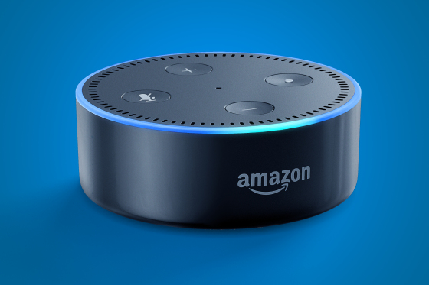
Design Example
Group: Chris, Yestin
Name: Music player Bot
Function: Play/pause music, add to playlist, shuffle, next/previous track
Notes:
https://www.youtube.com/watch?v=hPXS7rC1PWo

